Slide 1
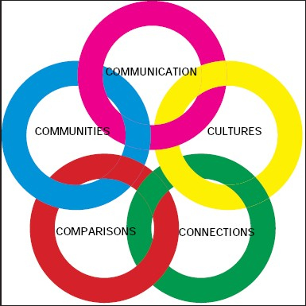

Slide 2
COMMUNICATION Communicate in Languages Other Than English
Standard 1.1: Students engage in conversations, provide and obtain information, express feelings and emotions, and exchange opinions
Standard 1.2: Students understand and interpret written and spoken language on a variety of topics
Standard 1.3: Students present information, concepts, and ideas to an audience of listeners or readers on a variety of topics.

Slide 3
CULTURES Gain Knowledge and Understanding of Other Cultures
Standard 2.1: Students demonstrate an understanding of the relationship between the practices and perspectives of the culture studied
Standard 2.2: Students demonstrate an understanding of the relationship between the products and perspectives of the culture studied

Slide 4
CONNECTIONS Connect with Other Disciplines and Acquire Information
Standard 3.1: Students reinforce and further their knowledge of other disciplines through the foreign language
Standard 3.2: Students acquire information and recognize the distinctive viewpoints that are only available through the foreign language and its cultures

Slide 5
COMPARISONS Develop Insight into the Nature of Language and Culture
Standard 4.1: Students demonstrate understanding of the nature of language through comparisons of the language studied and their own
Standard 4.2: Students demonstrate understanding of the concept of culture through comparisons of the cultures studied and their own.

Slide 6
COMMUNITIES Participate in Multilingual Communities at Home & Around the World
Standard 5.1: Students use the language both within and beyond the school setting
Standard 5.2: Students show evidence of becoming life-long learners by using the language for personal enjoyment and enrichment.

