Slide 1
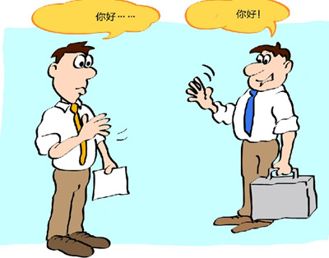

Slide 2
As a learner
How to listen to, understand and say it?
How to read, understand, and write it?
How to interact with speakers using the target language?

Slide 3
As an instructor
Learning strategy/approach: How to learn how to say/write it (most effectively)?
Pedagogy: How to teach how to say/write it (most effectively)?

